Slide 1
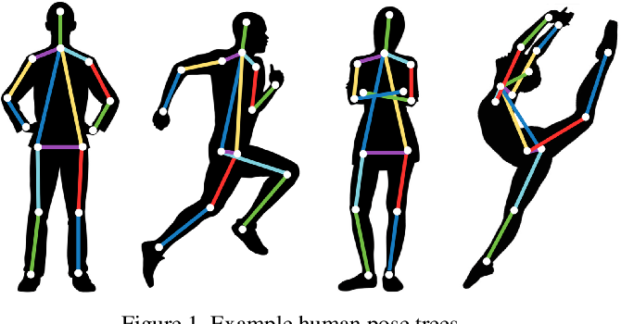
Human Activity Recognition using Pose Estimation Name: Onkar Pednekar Student ID: 801275237
Image Source

Slide 2
Problem Statement
A Human Activity Recognition (HAR) system's goal is to predict a person's action label from an image or video. Pose information is used by one of the most popular vision-based HAR systems. Poses reveal important information about human behavior. Using the BlazePose with MediaPipe library, we extract human poses (32 body keypoint locations in a two-dimensional plane) from images. Finally, using the pose information, activity is classified using a mathematical algorithm. We would be classifying various activities like Standing, Falling and Moving using the keypoint values for various body locations.

Slide 3
Motivation
I have always wondered how the human activites can be detected through camera surveillance.
Activity recognition is the basis for the development of many potential applications in health,
wellness, or sports.
Monitor Health: Analyze the activity of a person from the information collected by different devices. We can detect if the person is healthy based on the way he/she is walking or running.
Fall Detection: We can use HAR to check if a patient has fallen from bed.
Gym Reps Counting: Using keypoint location and activity we can count the number of reps done by a person/ number of pushups done by a person.
Vast number of advantages of HAR in various domains aroused my interest in pursuing this
topic.

Slide 4
Dataset
We would not be using any dataset, since we already have a pretrained model provided by Mediapipe for detecting the Keypoint Locations.
The dataset used by BlazePose implementation on MediaPipe is not publicly available, hence no link to provide about the dataset.
For detecting the activity we would be using algorithmic approach to find the activity based on keypoint location along X and Y axis.
Hence no dataset would be required for this task.

Slide 5
Summary of Method
The selected method, BlazePose, gives us keypoint locations for various body parts. Using this keypoints we can then find the activity of the person.
Currently I’m thinking of implementing three activities, ie Standing, Moving and Sleeping(Falling)
Standing: For this activity, we compare the keypoint locations of consecutive frames and if the difference between them is not greater than a threshold, ie it is less, then the activity is categorized as Standing.
Moving: We compare the keypoint locations of consecutive frames and if the difference between them is greater than a threshold, ie it is large, then the activity is categorized as Moving.
Sleeping: We compare the keypoint location of head along the Y-axis. If it is larger than a certain Y- axis threshold, ie it is on the lower end of the frame, then it means the person has fallen down and the activity is categorized as Falling.

Slide 6
Research Paper
Title: BlazePose: On-device Real-time Body Pose tracking
Authors: Valentin Bazarevsky, Ivan Grishchenko, Karthik Raveendran, Tyler
Zhu, Fan Zhang, Matthias Grundmann
Year: 2020
Journal: IEEE (Found on ARXIV.org)
Paper Link: BlazePose
Implementation using Mediapipe: Link

Slide 7
Related Work
Title: OpenPose- Realtime Multi-Person 2D Pose Estimation
Author: Zhe Cao, Gines Hidalgo, Tomas Simon, Shih-En Wei, Yaser Sheikh
Year: 2018
Journal Name: IEEE (Found on ARXIV.org)
This paper implements the same task of Pose Estimation using a different approach and neural network architecture.
Paper Link: OpenPose

Slide 8
Related Work
Title: DeepPose: Human Pose Estimation via Deep Neural Networks
Author: Alexander Toshev, Christian Szegedy
Year: 2013-2014
Journal Name: IEEE (Found on ARXIV.org)
This paper implements the Pose Estimation problem using Deep Neural Network.
Paper Link: DeepPose

Slide 9
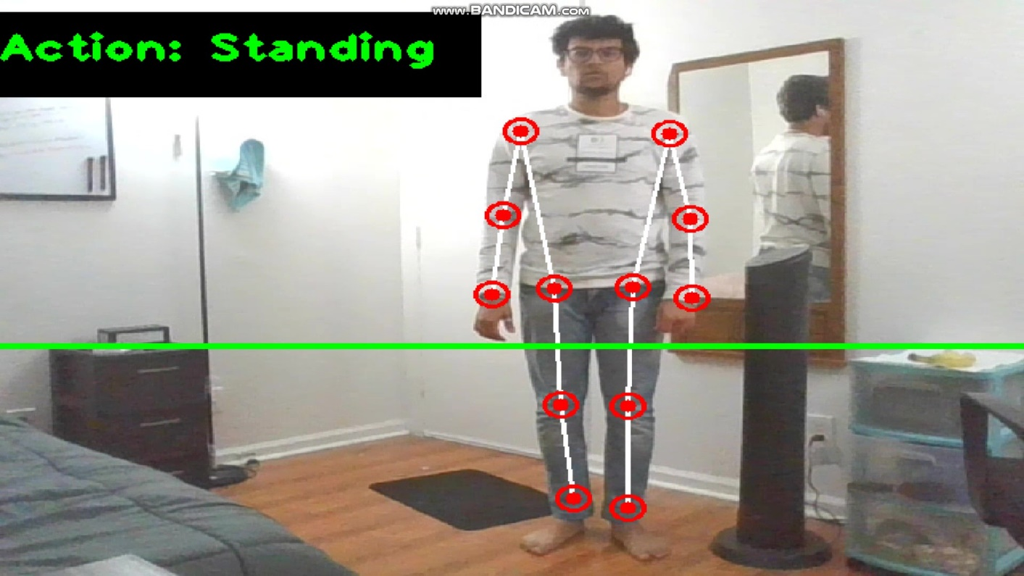
Results and Observation
Action: Standing

Slide 10
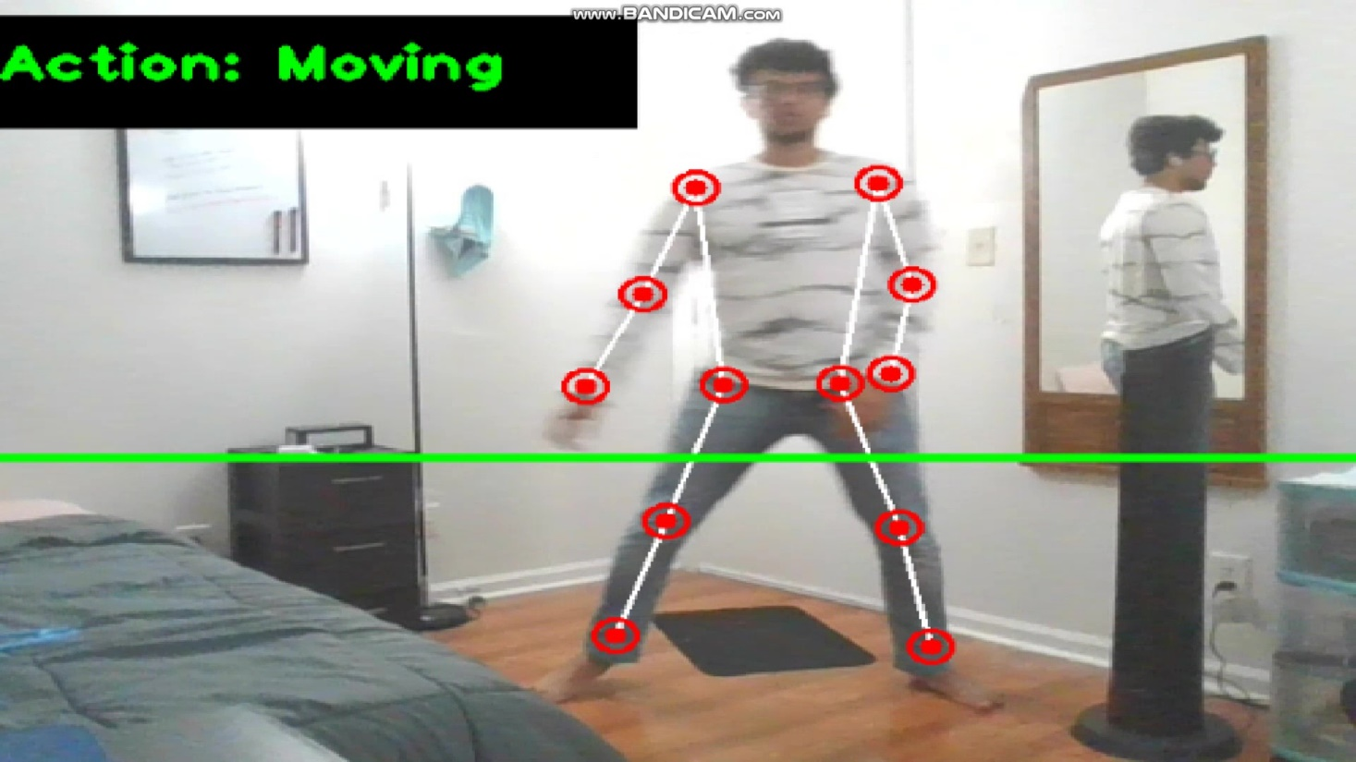
Results and Observation
Action: Moving

Slide 11
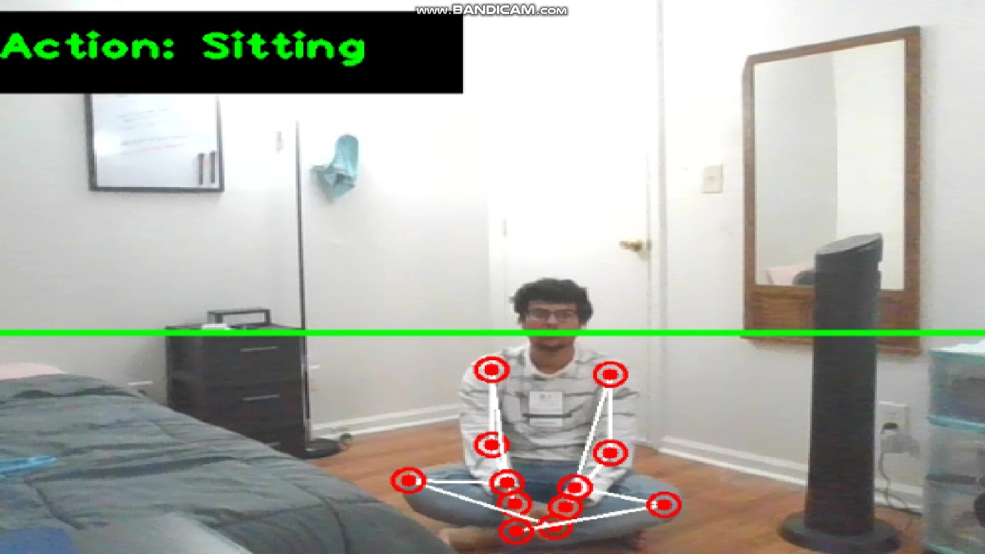
Results and Observation
Action: Sitting

Slide 12
Conclusion
So to conclude, I will be using BlazePose to find the keypoints of various body part locations with respect to the frame.
Based on these keypoints, I would be detecting the activity using a complex mathematical algorithm.
The key learning of this project would be using transfer learning, or using pretrained models for our own use case and performing Pose Estimation on a real time video feed.

